Slide 1
Training 2020
By
C. cunningham
r. Cunningham

Slide 2
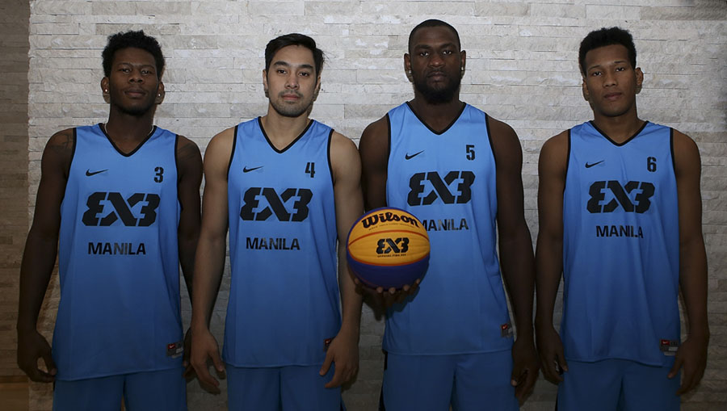
The game
HTTPS://YOUTU.BE/OUX-EMNQVRG
A regular 3x3 game is played on half court with 4 team members
3 players 1 substitute.
You must have 3 to start

Slide 3
Game continue
The length of the game is 10 mins. (The team with the most points at 10mins win)
Or 21 points whichever is first.
There is 1 minute between regular play and over time.
If a game is tied the first team to score 2 wins and the game is over
1 time out per team
The table can consist up to 3 persons Scorer, clock and shot clock operator

Slide 4
Check ball ART17
Possession of the ball given to either team following any deadball situation shall start/ resume with a check ball, i.e an exchange of the ball ( between the defensive and offensive player) behind arc at the top of the playing court.
At the beginning of the regular playing time or overtime the check ball should be administered by the official.
https://youtu.be/zzhTYx_mB4k

Slide 5
Clearing the Ball Art 30
clearing the ball is the way of playing, which grants and new offensive team a possession of the ball from behind the arc to do its best to attempt a shot for a field goal.
Following each successful field goal or the last free throw ( except those followed by ball possession):
A player from the non-scoring team shall resume the game by dribbling or passing the ball from inside the court directly underneath the basket ( not from behind the end line) to a place on the court behind the arc.
The defensive player is not allowed to play for the ball in the no charge semicircle area underneath the basket.
A player is considered to be behind the arc when neither of his feet is inside or on the arc line.

Slide 6
Clearing continued........
Following each unsuccessful field goal or last free throw (except those followed by ball possession).
If the offensive player rebounds the ball he may continue to attempt to score without returning the ball behind the arc.
give the defensive player rebounds the ball he must return the ball behind the arc by passing dribbling.
If the defensive team steals or blocks the ball it must return the ball behind the arc by passing or dribbling.

Slide 7
Intervals of play art.8.2
An interval of play begins:
When the player introduction starts (if any) but no later than when the players entered the playing court.
when the game Clock signal sounds for the end of the regular playing time if an overtime must be played.
An interval of play ends:
At the beginning of regular playing time or overtime when the ball is in the hands of the offensive player after the check ball has been completed.

Slide 8
the Clock and status of the ball art.1o
The game time is 1 10-minute period the clock stops only during a dead ball or free throws.
The ball can be either live or dead
Ball is live and the Clock starts:
During a check-ball, the ball is at the disposal of the offensive player after the check-ball has been completed. And remains alive until an official blows his whistle or the game/shot clock sounds.
The ball is at the disposal of the shooter
After a successful last free throw, the next offensive team is in possession of the ball.
After an unsuccessful last free throw and the ball continues to be live, the ball touches or is touched by any player on the playing court.
https://youtu.be/RD9M4XiaqLM

Slide 9
The clock stops or the ball is dead
The ball becomes dead when;
an official blows the whistle while the ball is Live.
It is apparent the ball will not enter the basket on a free throw which is to be followed by
another free throw
further penalty ( free throws and/or possession).
The game Clock signal sounds for the end of the regular playing time or sudden death overtime
The shot Clock signal sounds while a team is in control of the ball.

Slide 10
Continue...........
The ball in flight on a short for field goal is touched by a player from either team after:
An official blows his whistle.
The game Clock signal sounds for the end of the regular playing time.
The shot Clock signal sounds.
The ball does not become dead and the goal counts if made when:
The ball is in flight on a short for a field goal and:
- an official blows his whistle.
- the game Clock signal sounds for the end of the regular playing time.
- The shot Clock signal sounds

Slide 11
Time – out art. 18
Time out is an interruption of the game requested by a player or substitute to the official.
Each timeout is 30 seconds.
Each team has one timeout that can be carried over to the overtime.
A timeout may not be requested on a live ball.
In addition to the one time out there is a TV timeout that should be granted after the Clock shows 6:59 and 3:59 if so decided by the organizers.

Slide 12
Substitutions art. 19
A substitution is an interruption of the game requested by the substitute to become a player.
Both teams are entitled to request a substitution when the ball becomes dead prior to a check ball or a free throw.
The substitute can enter the game without any prior notice to the officials or table officials while the ball is dead and the game Clock is stopped.
The substitutions can only take place behind the end line and require no action from the officials or table officials.
Substitute may be substituted between the first and 2nd free throws.

Slide 13
Beginning the game /and scoring art. 9 art. 16
Teams warm up together before the start of the game.
The game starts with a coin toss
The winning team decides whether they want possession to start the game or at the beginning of a potential overtime.
Every shot from inside the arc is 1pt.
Every shot outside the arc is 2pts
Every successful free throw is rewarded 1pt.
https://youtu.be/nWG-0GPalQQ

Slide 14
Q and A

Slide 15
The game DAY 2
HTTPS://YOUTU.BE/OUX-EMNQVRG

Slide 16
The shot clock art. 29
Teams must attempt a short for field goal within 12 seconds.
If there is no visible shot Clock the official must keep the count and give the teams a 5 second warning by counting down a loud.
Teams are not allowed to stall the ball (not attempting to score)or failing to play actively is a violation.

Slide 17
Shot clock start/restart
The shot Clock operator should be provided with a short Clock which shall be started or restarted when:
on the playing court a team gains control of a live ball. After that the mere touching of the ball by an opponent does not start a new short Clock if the same team remains in control of the ball.
On a check ball the ball is at the disposal of the offensive player after the check ball has been completed.

Slide 18
Shot clock – stopped but not reset
When the same team that previously had control of the ball is awarded a check ball as the result of:
- a ball gone out of bounds
- a player of the same team is injured
- technical foul committed by that team
- a double foul
- a cancellation of equal penalties on both teams.
- The game is stopped because of an action not connected with either team unless that team would be placed at a disadvantage.

Slide 19
Shot Clock
The shot Clock should be reset whenever the game is stopped by an official:
For a foul or violation (not for the ball had been gone out of bounds) by the team not in control of the ball.
For any valid reason by the team not in control of the ball.

Slide 20
Shot clock
If the game is stopped by an official for any valid reason not connected with either team the short Clock should not be reset but continued from the time it was stopped unless in the judgment of an official it would place the team at a disadvantage.
The shot Clock should be reset to 12 seconds whenever a check ball is awarded to the opponent's team after the game stopped by an official for foul or violation (including for the ball going out of bound) committed by the team in control of the ball.
The shot Clock shall also be reset to 12 seconds if the new offensive team is awarded a check ball as result of a jump ball situation.
The shot clock shall also be reset after the ball has touched the ring or enters the basket
The short Clock shall be reset to 12 seconds whenever any player gains control of the ball.

Slide 21
Scorer art. 48
The scorer shall complete the score sheet by entering the teams and names and numbers of the players who are participating in the game.
Keep the running summary of points scored by entering the field goals and the free throws made.
Keep the fouls charged on each team.
Notify official when 6 team fouls as well as 10 team fouls are charged to any team.
Enter the unsportsmanlike fouls charged on any player and notify when anyone has received 2 unsportsmanlike foul.
Keep timeouts
Keep record of who won the coin toss.

Slide 22
Score sheet

Slide 23
Team Fouls penalty art. 41
Teams are allowed 6 team fouls before the penalty.
Teams foul 7, 8 and 9 should always be penalized with two free throws.
Team fouls 10 and any other team fouls should be panelized with 2 free throws and ball possession.

Slide 24
PLayer Fouls
Players illegal contact is called a contact foul which are entered on the score sheet as team fouls.
(A contact foul is is an illegal contact with an opponent wherether the ball is live or dead).
Technical fouls are also entered as team fouls.
Players are not excluded from the game based on the number of contact fouls or technical fouls.
Players are only charged with Unsportsman like fouls and Disqualifing fouls. Two unsportsman like fouls excludes you from the game.
Unsportsman foul and disqualifing fouls counts as 2 team fouls.
The penalty for the first unsportsman like foul is two shots and no possesion. If the player is in the act of shooting and the shoot is made he is still awarded 2 freethrows.
According to art.37.2 the second unsportsman like foul on a player shall be penanlized with 2 freethows and posession.

Slide 25
Fouls penalty art. 34 /art 41
The shot release from the field goal area if successful the goal should count and In addition one free throw or 2 free throws should be awarded as of the 7th team foul.
If the shot released from the inside of the arch is unsuccessful one free throw if it is the 7th team foul its two free throws.
If the short released from behind the arc is unsuccessful two free throws.

Slide 26
Unsportman Fouls
Player U-Foul | Team Foul 1 - 6 | Team Foul 7-9 | Team Foul 10+
1 st U-Foul | 2 free throws | 2 free throws | 2 free throws + possession
2nd U-Foul | 2 free throws + possession | 2 free throws + possession | 2 free throws + possession

Slide 27
T-Foul Defensive Player | T-Foul offensive player | No team in Ball Possession
1 free throw | 1 free throw | 1 free throw
Possession for offensive team | Possession for Offensive team | Possession for the last defensive team
Shot clock reset to 12sec | No reset of shot clock | Shot clock reset to 12sec

Slide 28
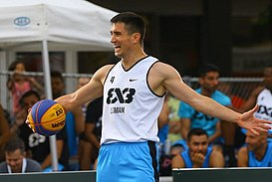
conclusion
The Game is:
Simple
1 hoop,
1 half court
2 teams of 3 + 1 sub each

Slide 29
So what's the difference
RULE | 3X3 | 5V5
HOOP | 1 | 2
COURT | HALF | FULL
PLAYERS | 3-A-SIDE | 5-A-SIDE
BALL | 3X3 | 5V5
PLAYING TIME | 10' | 4 X 10'
GAME OVER | 21 PTS | N/A
SHOT-CLOCK | 12" | 24"
FIELD GOALS | 1 OR 2 PTS | 2 OR 3 PTS
AFTER SCORING | NO BREAK | INBOUND

Slide 30
The game is:
The Game is:
Fast
10-minute game
12-second shot-clock
No break after scoring
No half-time
No quarters

Slide 31
Last but in no means least
The Game is:
Entertaining
Game over at 21 pts
First to 2 pts wins OT
Non-stop music

Slide 32
Q and A

